Slide 1

8th Grade Math: Pre-Algebra
Unit 14, Lesson 1 Determining Sample Space Using Lists and Tree Diagrams Volume 2, pg. 307

Slide 2


Benchmarks
MA.8.DP.2.1
Determine the sample space for a repeated experiment.
MA.8.DP.2.2
Find the theoretical probability of an event related to a repeated experiment.
volume 2, pg. 307

Slide 3
Integrated Mathematical Thinking and Reasoning Standards
MA.K12.MTR.1.1 Actively participate in effortful learning both individually and collectively.
MA.K12.MTR.5.1 Use patterns and structure to help understand and connect mathematical concepts.
MA.K12.MTR.7.1 Apply mathematics to real-world contexts.
volume 2, pg. 307

Slide 4

Learning Targets
I can determine the sample space of an experiment using a list.
I can understand how a tree diagram can be used to determine the sample space of an experiment.
volume 2, pg. 307

Slide 5

Warm-Up
volume 2, pg. 307

Slide 6
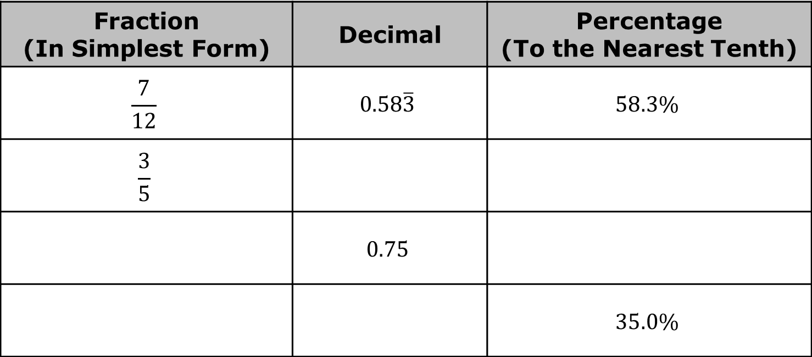
14.1.1 Warm-Up: Equivalent Forms
Complete the table so each row shows the same value in three equivalent forms.
Fraction (In Simplest Form) | Decimal | Percentage (To the Nearest Tenth)
$$\frac{7}{12}$$ | $$0.58\overline{3}$$ | $$58.3\%$$
$$\frac{3}{5}$$
 | $$0.75$$
 |  | $$35.0\%$$
volume 2, pg. 307

Slide 7

Refresher
volume 2, pg. 308

Slide 8


14.1.2 Refresher: Determining the Sample Space
Math is used every day to help make decisions. One branch of math that can be used to inform decisions is probability. In order to study the probability of a random process, it is important to be able to identify the sample space of the process.
An outcome is a possible result of an experiment.
In a probability model for a random process, the sample space is a list of the individual outcomes that are to be considered.
An event is a set of possible outcomes that can result from an experiment. In general, an event is any subset of a sample space.
volume 2, pg. 308

Slide 9
A familiar random process is rolling a fair die. List the possible outcomes of rolling a fair die.
This list is the ___________________ for the random process of rolling a fair die.
A sample space is useful for finding probabilities when each outcome in a random process is equally likely.
volume 2, pg. 308

Slide 10
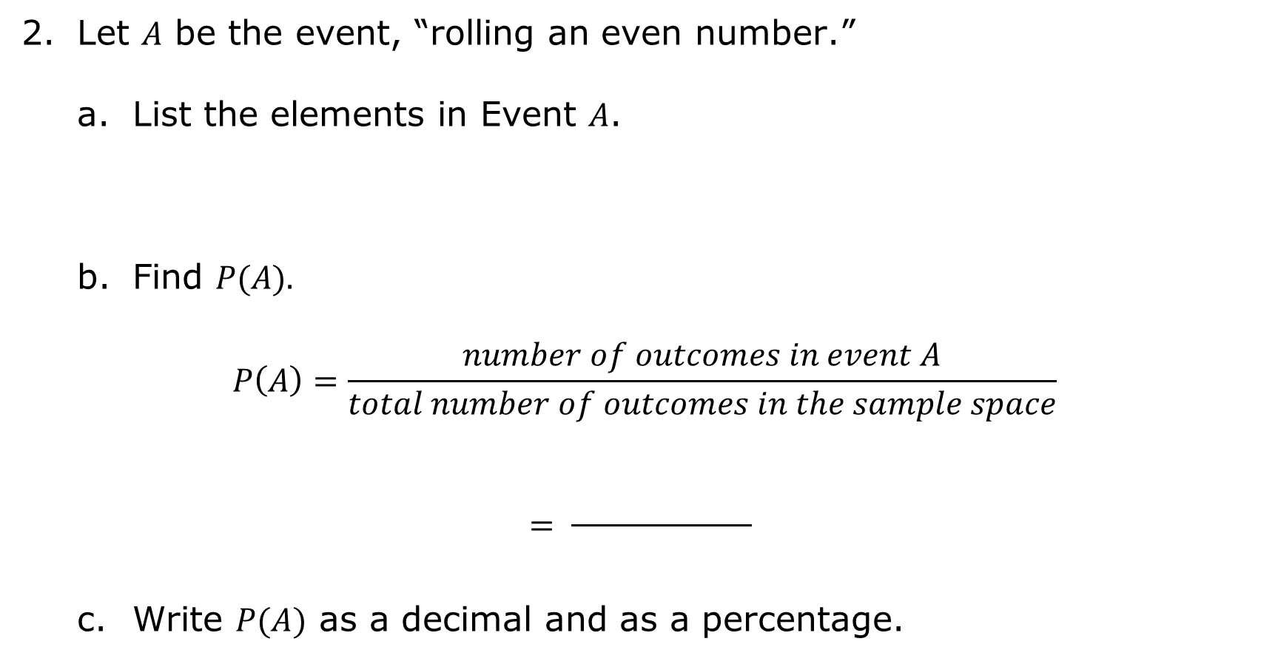
Let $A$ be the event, “rolling an even number.”
List the elements in Event $A$.
Find $P(A).$
$$P\left(A\right)=\frac{number of outcomes in event A}{total number of outcomes in the sample space}$$
$$= \frac{ }{ }$$
Write $P(A)$ as a decimal and as a percentage.
volume 2, pg. 308

Slide 11
A fair coin is flipped.
What is the sample space?
What is the probability of landing on heads?
volume 2, pg. 308

Slide 12

Exploration
volume 2, pg. 309

Slide 13

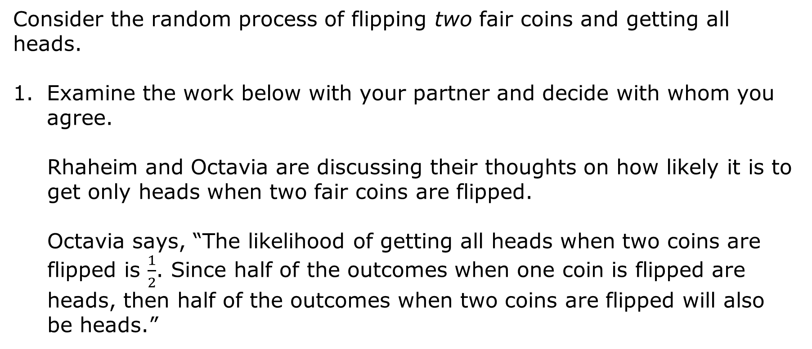
14.1.3 Exploration: Repeated Coin Flipping
Consider the random process of flipping two fair coins and getting all heads.
Examine the work below with your partner and decide with whom you agree.
Rhaheim and Octavia are discussing their thoughts on how likely it is to get only heads when two fair coins are flipped.
Octavia says, “The likelihood of getting all heads when two coins are flipped is $\frac{1}{2}$. Since half of the outcomes when one coin is flipped are heads, then half of the outcomes when two coins are flipped will also be heads.”
volume 2, pg. 309

Slide 14
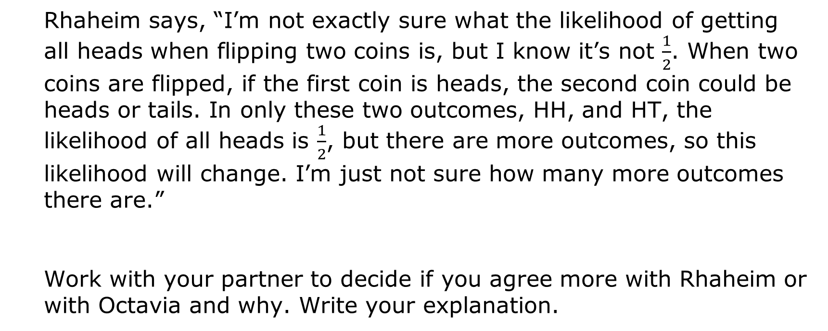
Rhaheim says, “I’m not exactly sure what the likelihood of getting all heads when flipping two coins is, but I know it’s not $\frac{1}{2}$. When two coins are flipped, if the first coin is heads, the second coin could be heads or tails. In only these two outcomes, HH, and HT, the likelihood of all heads is $\frac{1}{2}$, but there are more outcomes, so this likelihood will change. I’m just not sure how many more outcomes there are.”
Work with your partner to decide if you agree more with Rhaheim or with Octavia and why. Write your explanation.
volume 2, pg. 309

Slide 15
List the sample space of flipping a fair coin twice. On the first toss, the possible options are heads and tails. On the second toss, the two options are heads and tails.
Use the sample space to determine how likely it is to flip all heads when two coins are flipped. Create a ratio to compare the number of outcomes with only heads to the total number of outcomes in the sample space.
volume 2, pg. 309

Slide 16
What if three fair coins are flipped? How will the sample space and the likelihood of flipping only heads change?
Make a prediction below.
Work with your partner to determine the sample space when three fair coins are flipped.
volume 2, pg. 309

Slide 17
Find the likelihood of flipping all heads when three fair coins are flipped.
Compare your work with that of another pair of students. Revise your work to make it more accurate, if necessary.
volume 2, pg. 310

Slide 18
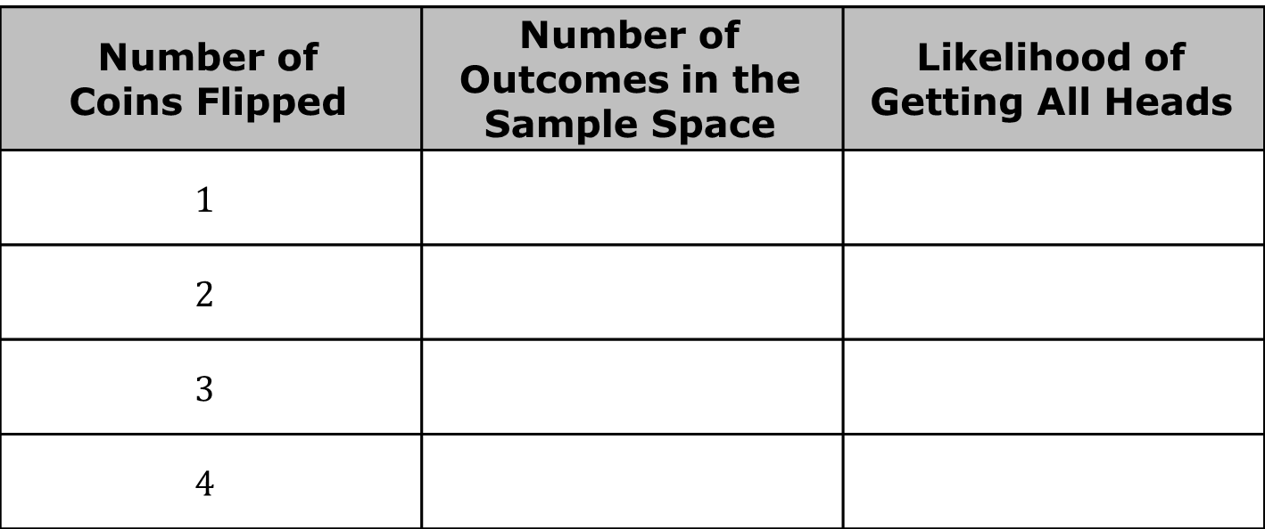
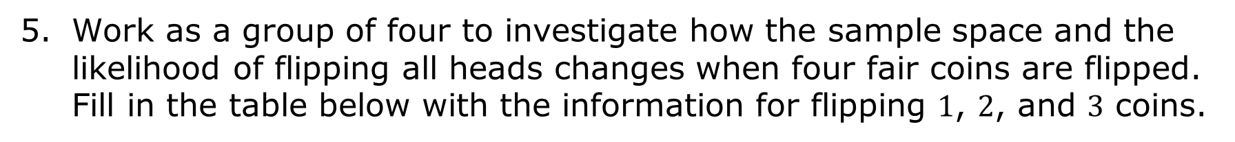
Work as a group of four to investigate how the sample space and the likelihood of flipping all heads changes when four fair coins are flipped. Fill in the table below with the information for flipping $1$, $2$, and $3$ coins.
Number of Coins Flipped | Number of Outcomes in the Sample Space | Likelihood of Getting All Heads
$$1$$
$$2$$
$$3$$
$$4$$
volume 2, pg. 310

Slide 19
Use the table above to make a prediction about how the sample space and likelihood of getting all heads will change when four fair coins are flipped.
Flipping a fair coin multiple times is an example of a repeated experiment. Each repetition — in this case, a coin toss — is a trial.
A repeated experiment is a random experiment done with the same conditions and parameters as a previous one.
volume 2, pg. 310

Slide 20

Guided Instruction
volume 2, pg. 311

Slide 21

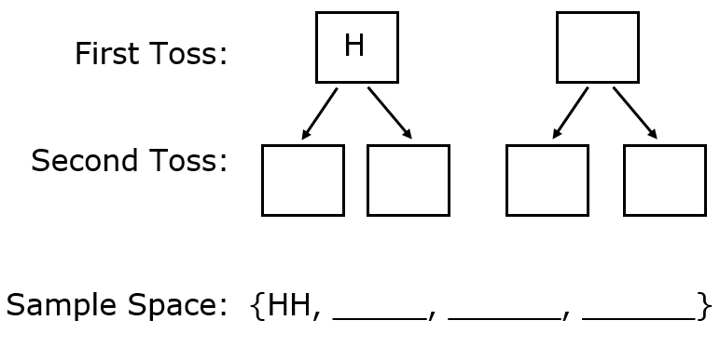
14.1.4 Guided Instruction: Tree Diagrams
In addition to making a list, tree diagrams can also be used to determine the sample space for a repeated experiment.
Follow the prompts below to complete a tree diagram showing all possible outcomes when a fair coin is flipped two times
This display is called a tree diagram, and it helps visualize the sample space.
volume 2, pg. 311

Slide 22
Write the possible outcomes for the first coin toss.
b. Write the possible outcomes for the second coin toss.
c. Write the sample space.
d. Complete the table.
Experiment | Number of Outcomes in the First Step | Number of Outcomes in the Second Step | Total Number of Outcomes in the Sample Space
Flipping a fair coin two times
volume 2, pg. 311

Slide 23
Suppose a fair coin is tossed three times.
Create a tree diagram to determine the sample space of flipping a fair coin three times.
volume 2, pg. 311

Slide 24
How many outcomes are in the sample space?
Experiment | Number of Outcomes in the First Step | Number of Outcomes in the Second Step | Number of Outcomes in the Third Step | Total Number of Outcomes in the Sample Space
Flipping a fair coin three times
volume 2, pg. 312

Slide 25
c. How many outcomes are in Event A = Flipping all heads?
d. How many outcomes are in Event B = Flipping exactly one head?
Tree diagrams can also be set up horizontally.
The sample space for rolling a fair die two times can be displayed in a tree diagram. Complete the tree diagram for rolling a 3 on the first roll.
volume 2, pg. 312

Slide 26
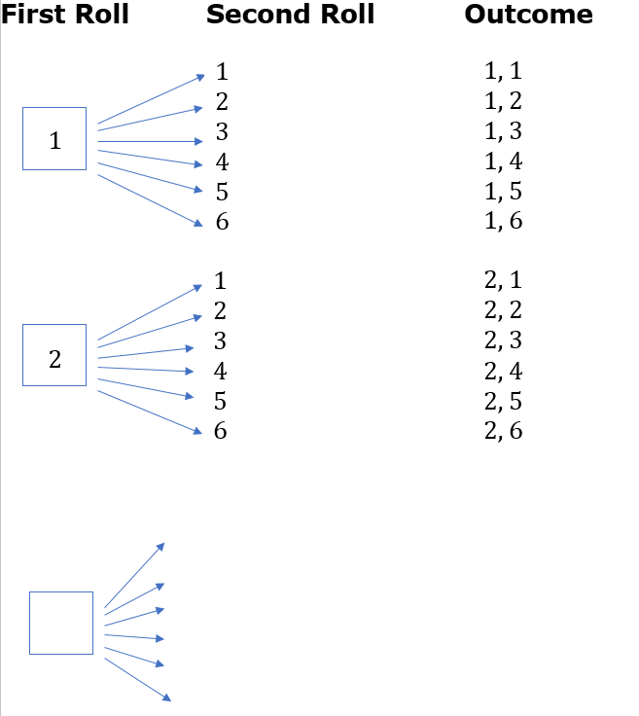
volume 2, pg. 312

Slide 27
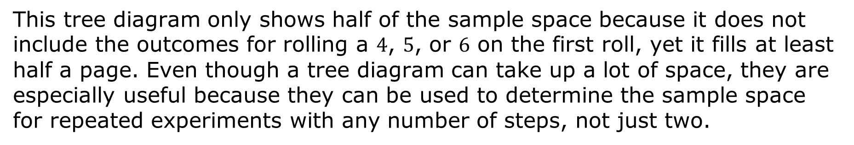
This tree diagram only shows half of the sample space because it does not include the outcomes for rolling a $4$, $5$, or $6$ on the first roll, yet it fills at least half a page. Even though a tree diagram can take up a lot of space, they are especially useful because they can be used to determine the sample space for repeated experiments with any number of steps, not just two.
volume 2, pg. 312

Slide 28

Wrap-Up
volume 2, pg. 313

Slide 29
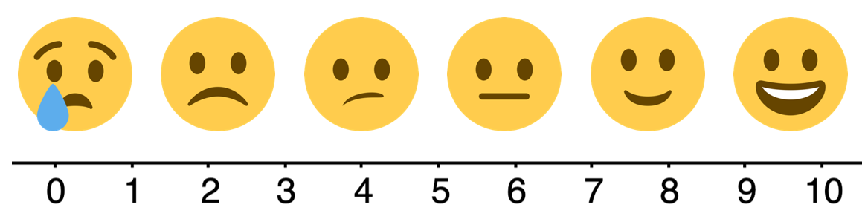
14.1.5 Wrap-Up: Reflection
Use the scale below to rate your ability to determine the sample space of a random process.
10 = I can teach someone else how to determine the sample space of a random process.
0 = I don’t know what a sample space is.
volume 2, pg. 313

Slide 30
What questions or comments do you have about determining the sample space of a random process?
volume 2, pg. 313

